Slide 1
NoSQL Databases (18CS823) (Module 2)
Presenter:
Mrs. Ancy Thomas
Assistant Professor
Department of Computer Science and Engineering
Acharya Institute of Technology

Slide 2
NoSQL databases: Aggregated DBs
NoSQL data models
Key-value, document, column databases
Distribution models
Consistency
Map-Reduce

Slide 3
Module 2

Slide 4
Distribution Models
As said, the primary driver of interest in NoSQL has been its ability to run databases on a large cluster
In particular, aggregate orientation fits well with scaling out because the aggregate is a natural unit to use for distribution
Let us now have a look to various models for data distribution
Sharding
Master-slave replication
Peer-to-peer replication

Slide 5
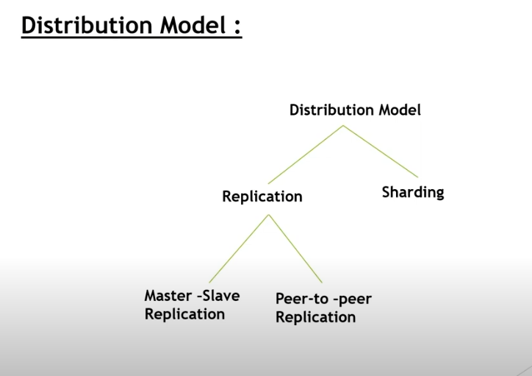

Slide 6
Single Server
Single machine - read and writes to the data store
Eliminates complexities
Easy for operational people
Graph database

Slide 7
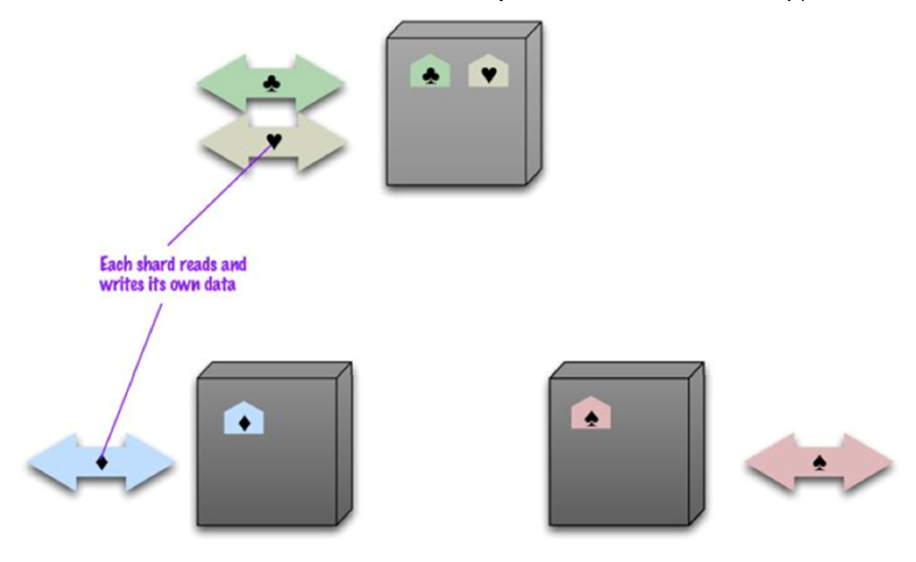
Sharding
Often, a busy data store is busy because different people are accessing different parts of the dataset. In these circumstances we can support horizontal scalability by putting different parts of the data onto different servers. This technique is called Sharding

Slide 8
Sharding
Two main issues arise in Sharding:
how to clump the data, so that one user mostly gets his/her data from a single server
how to arrange single data clumps on the nodes to provide the best data access
As for point 1, we recall that we generally design aggregates to combine data that are commonly accessed together. So aggregates leap out as an obvious unit of distribution
As for point 2, there are several factors that can help improve performance. If you know that most accesses of certain aggregates are based on a physical location, you can place the data close to where it is being accessed. Another factor is trying to arrange aggregates so they are evenly distributed across the nodes which all get equal amounts of the load. This may vary over time

Slide 9
Sharding
Sharding is particularly valuable for performance because it can improve both read and write performance
Sharding however does little to improve resilience when used alone: Although the data is on different nodes, a node failure makes that shards data unavailable just as surely as it does for a single-server solution. The resilience benefit it does provide is that only the users of the data on that shard will suffer, which is however not that much! Furthermore, we notice that clusters often use less reliable machines than those adopted in single-server solutions, and therefore node failures can be more frequent. So in practice, sharding alone is likely to decrease resilience
Many NoSQL databases offer auto-sharding, where the database takes on the responsibility of allocating data to shards and ensuring that data access goes to the right shard

Slide 10
Master-slave replication
With master-slave distribution, you replicate data across multiple nodes
One node is designated as the master, or primary, and is the authoritative source for the data, usually responsible for processing any updates to that data
The other nodes are slaves, or secondaries. A replication process synchronizes the slaves with the master

Slide 11
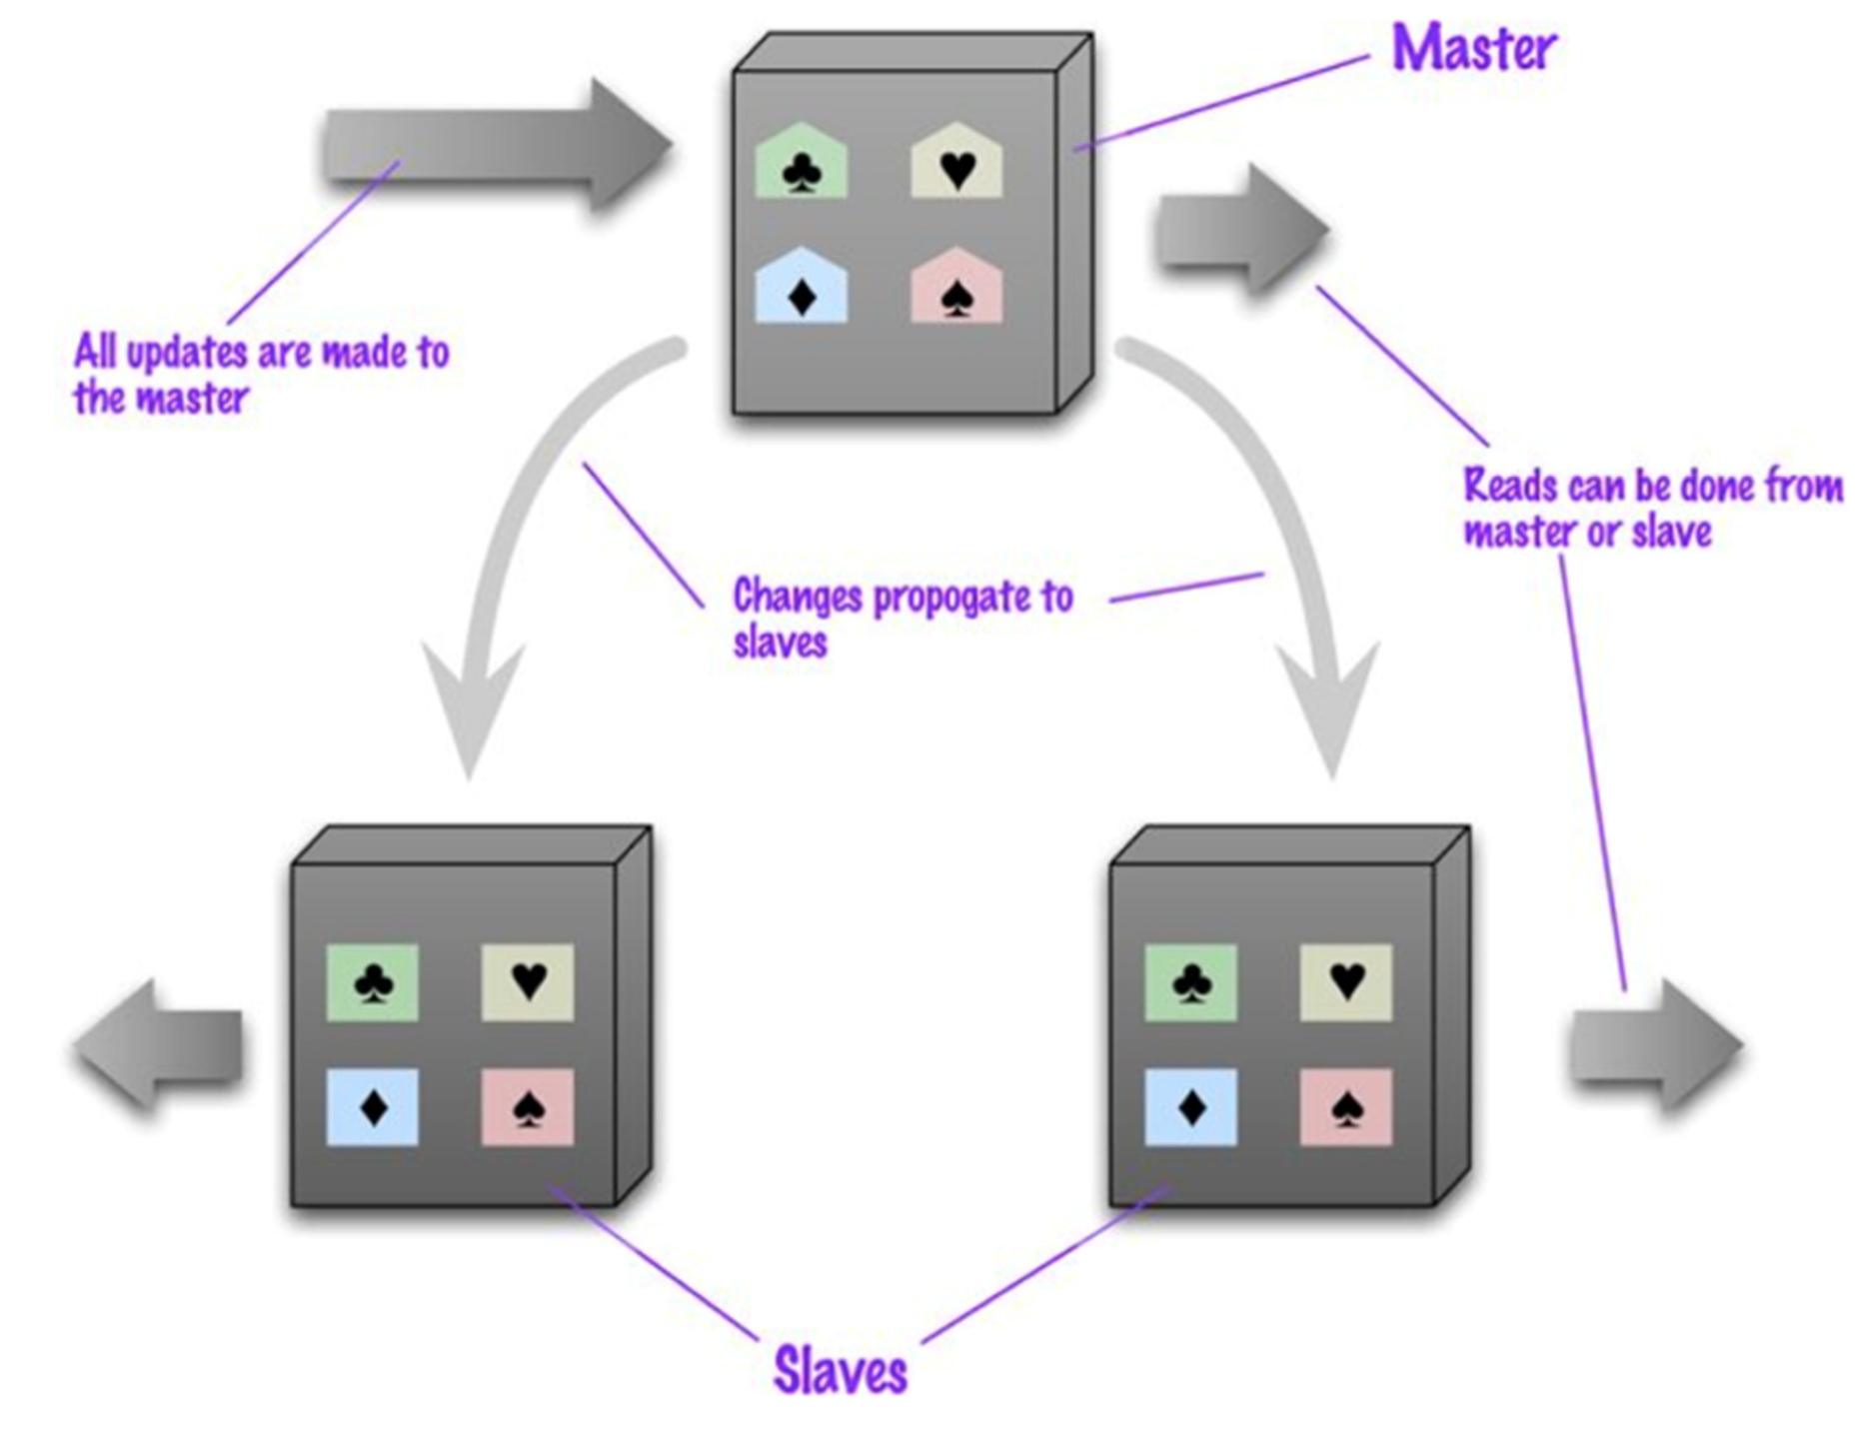
Master-slave replication

Slide 12
Master-slave replication
Master-slave replication is most helpful for scaling when you have a read-intensive dataset, since read accesses can be on any node, but it isn’t such a good scheme for datasets with heavy write traffic, since all writes must be routed to the master and than propagated to the slaves.
Also, should the master fail, the slaves can still handle read requests (read resilience)
The failure of the master however eliminates the ability to handle writes until either the master is restored or a new master is appointed. Having slaves as replicates of the master does speed up recovery after a failure
The main drawback is the arising of possible inconsistency.
You have the danger that different clients, reading different slaves, will see different values because the changes haven’t all propagated to the slaves!

Slide 13
Peer-to-peer replication
Master-slave replication helps with read scalability but doesn’t help with scalability of writes. It provides resilience against failure of a slave, but not of a master
Peer-to-peer replication attacks these problems by not having a master. All the replicas have equal weight, they can all accept writes, and the loss of any of them does not prevent access to the data store

Slide 14
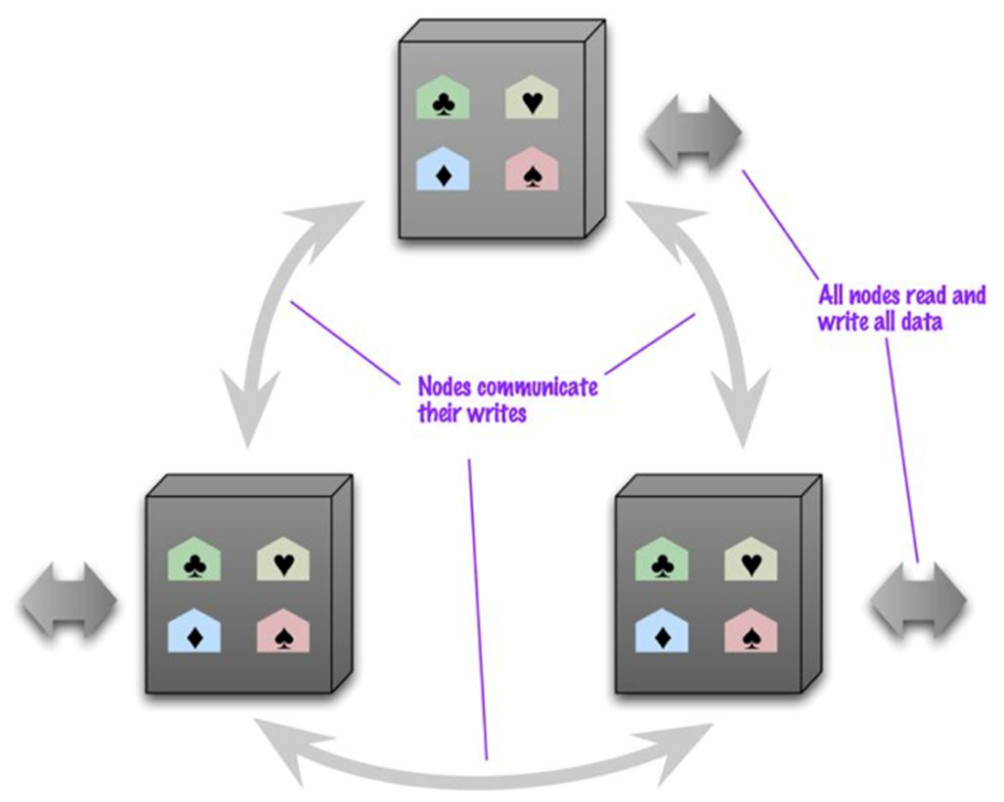
Peer-to-peer replication

Slide 15
Peer-to-peer replication
With a peer-to-peer replication cluster, you can ride over node failures without losing access to data. Furthermore, you can easily add nodes to improve your performance
The biggest complication is, again, consistency. When you can write to two different places, you run the risk that two people will attempt to update the same record at the same time: a write-write conflict!
Inconsistencies on read lead to problems but at least they are relatively transient. Inconsistent writes are forever!
There are various policies that can be adopted to cope with this problem. Here it is mentioned only some of them:
we can ensure that whenever we write data, the replicas coordinate one another to ensure we avoid a conflict (at the cost of network traffic to coordinate the writes)
In other cases we can decide we don’t need all the replicas to agree on the write, but just a majority
At the other extreme, we can decide to cope with an inconsistent write. There are contexts when we can come up with policy to successively merge inconsistent writes
62

Slide 16
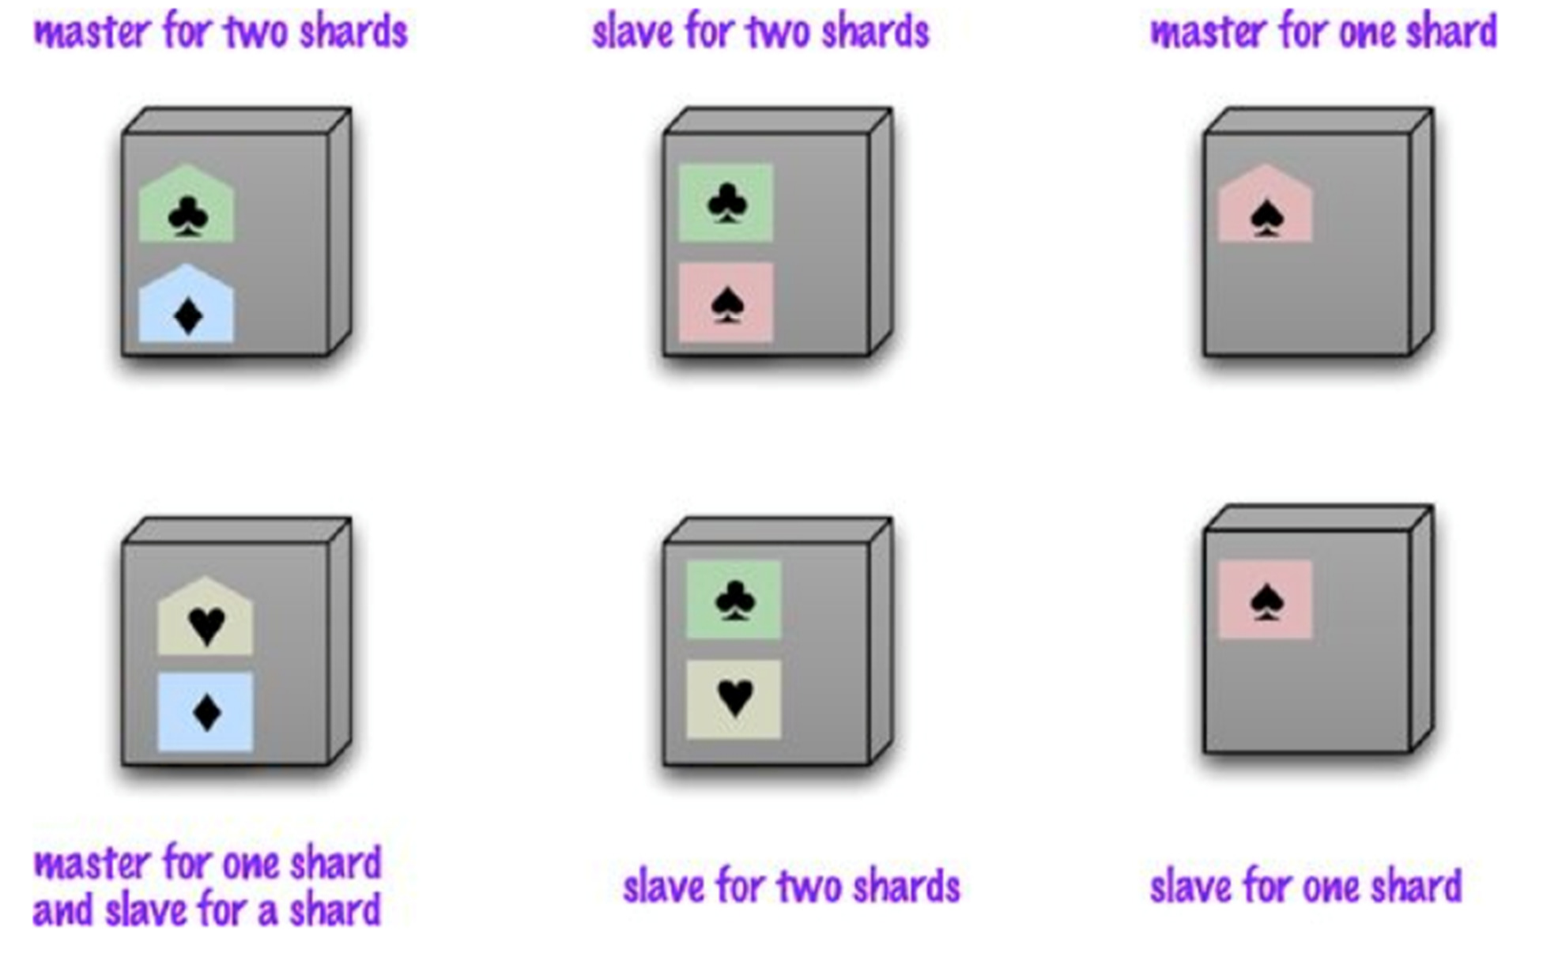
Sharding with Master-slave replication
If we use both master-slave replication and sharding, we then have multiple masters, but each data item only has a single master.

Slide 17
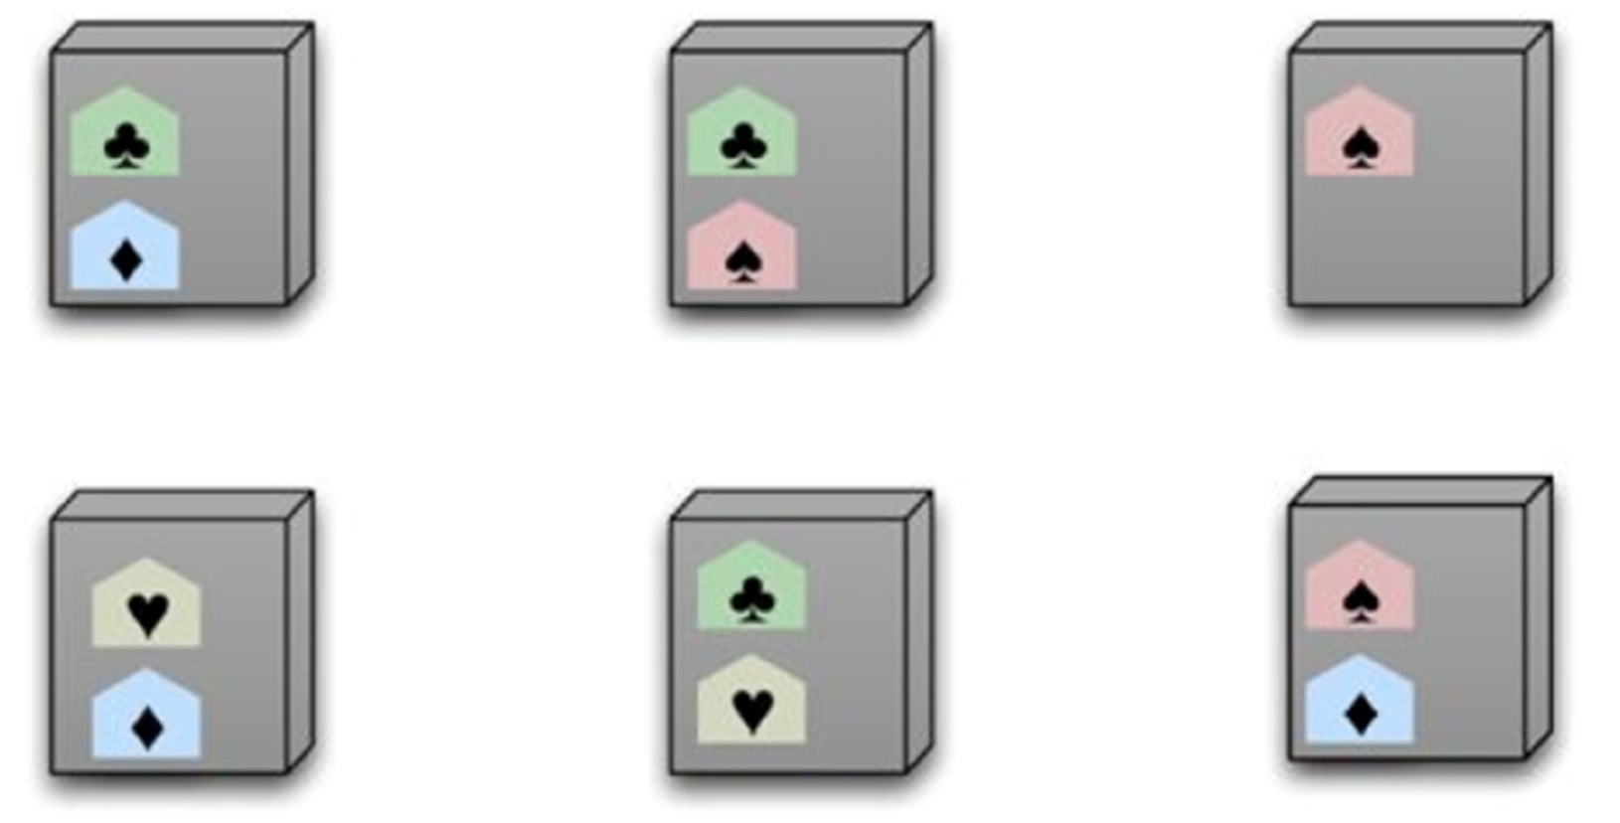
Sharding with P2P replication
Using peer-to-peer replication and sharding is a common strategy for column-family databases. Each shard is replicated in a peer-to- peer fashion
In a scenario like this you might have tens or hundreds of nodes in a cluster with data sharded over them. Should a node fail, then the shards on that node will be built on the other nodes

Slide 18
NoSQL databases: Aggregated DBs
NoSQL data models
Key-value, document, column databases
Distribution models
Consistency
Map-Reduce

Slide 19
Consistency
Informally: “every request receives the right response”
In relational databases the above aim is achieved through the enforcement of so-called ACID properties to database transactions (strong consistency)
Atomicity: every transaction is executed in “all-or-nothing” fashion
Coherence*: every transaction preserves the coherence with constraints
on data (i.e., at the end of the transaction constraints are satisfied by data)
Isolation: transaction does not interfere. Every transaction is executed as
it was the only one in the system (every seralization of concurrent transactions is accepted)
Durability: after a commit, the updates made are permanent regardless possible failures
*Note: In DB literature the term Consistency is often used in place of Coherence to indicate conformance of data with integrity constraints. However, here we use Consistency in a wider sense (e.g., it indicates the enforcement of all ACID properties), and thus we prefer to indicate constraints satisfaction as data Coherence.

Slide 20
Consistency
Transactions in relational DBMSs are such that:
Atomicity is always guaranteed
Coherence can be relaxed within the transaction (e.g., by deferring constraint checks), but it is enforced at the end of the transaction (when data are committed)
Durability is in general guaranteed (even though some in- memory databases may not fully meet this requirement)
Isolation is the most critical property, since independent transactions may interfere in various ways.

Slide 21
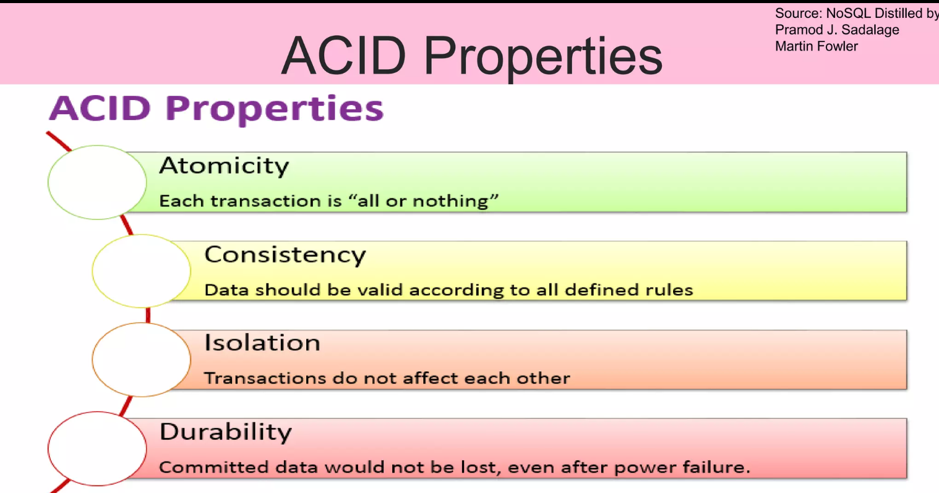

Slide 22
Consistency – Isolation in RDBMSs
Possible Conflicts between transactions T1 and T2 are classified as
Write-Read (WR): T1 reads data written by T2, which is still not committed (and that could be rolled-back)
Read-Write (RW): T1 reads data that T2 then updates (before T1 is committed)
Write-Write (WW): T2 overwrites data previously written by T1 (but before T1 is committed)
Isolation is ensured through the use of sophisticated lock mechanisms that assign a resource to a transaction in exclusive or shared modality
DBMSs allow users to set the desired isolation level, which means adopting a desired lock policy
The stricter lock policy guarantees serializability: the final effect on the DB is the execution of either the sequence T1-T2 or the sequence T2-T1
For performance reasons, often a weaker isolation level is adopted: for example, the Read-Committed level is enough to avoid WW and
WR conflicts
68

Slide 23
Consistency in NoSQL DBs
A common claim we hear is that NoSQL databases don’t support transactions and thus can’t be consistent
As we already said, any statement about lack of transactions usually only applies to some NoSQL databases, in particular the aggregate-oriented ones, whereas graph databases tend to support ACID transactions
Secondly, aggregate-oriented databases do support atomic operations, but only within a single aggregate. Consider the example in the previous slide and assume you have an aggregate database storing that data. If X, Y and Z are managed in the same aggregate, RW conflict can be avoided (logical consistency within an aggregate but not between aggregates)

Slide 24
Update consistency
As for updates, rather than a pessimistic approach, which works by preventing conflicts from occurring, an optimistic approach is often adopted, which lets conflicts occur, but detects them and takes action to sort them out
A common optimistic approach is a conditional update where any client that does an update (which may give rise to WW conflicts) tests the value just before updating it to see if it’s changed since her last read
There is another optimistic way to handle a write-write conflict — save both updates and record that they are in conflict. Then, you have to merge the two updates somehow (heavily application dependent)
These techniques are particularly relevant under P2P replication

Slide 25
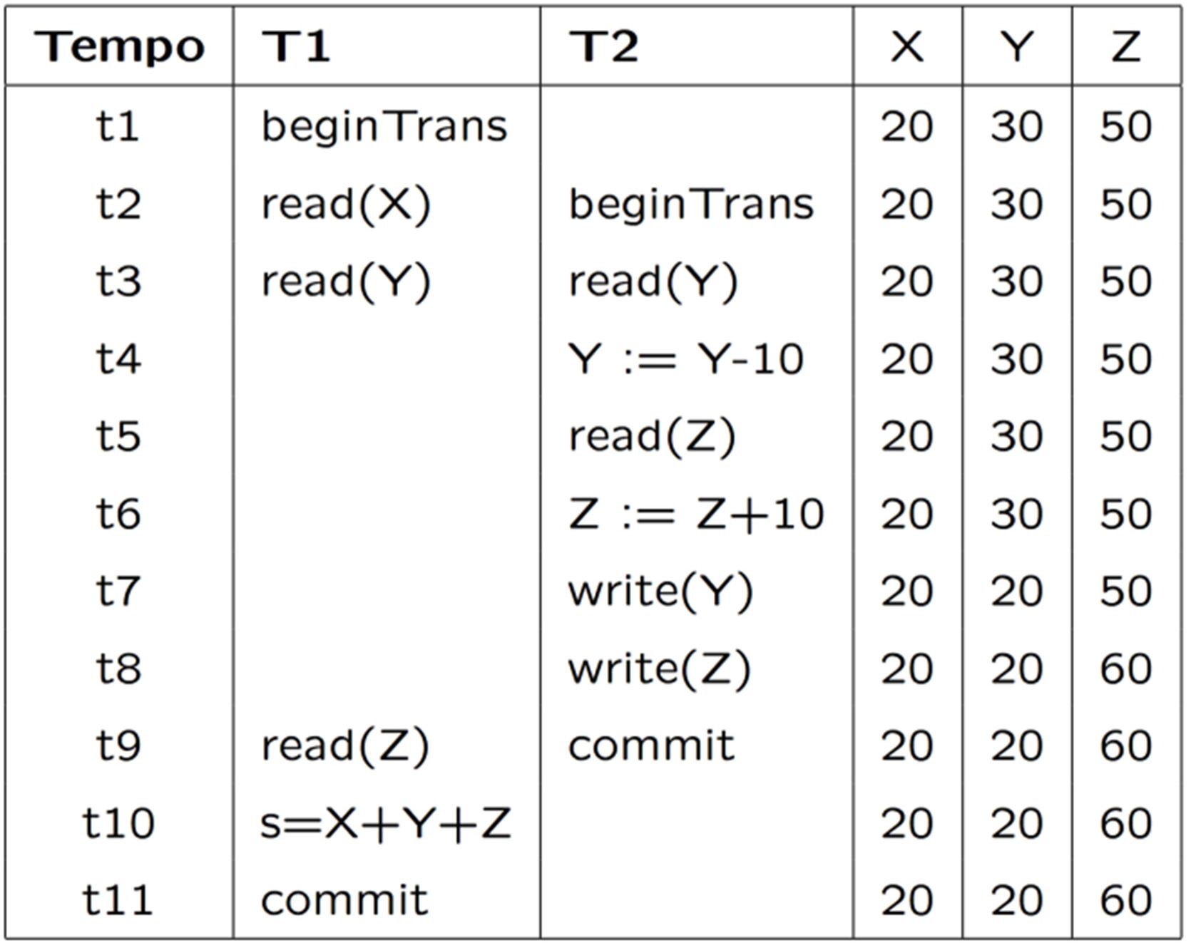
RW - example
In this example, we want to check whether X+Y+Z=100
This kind of conflicts is also called inconsistent read. Avoiding them means ensuring logical consistency
69

Slide 26
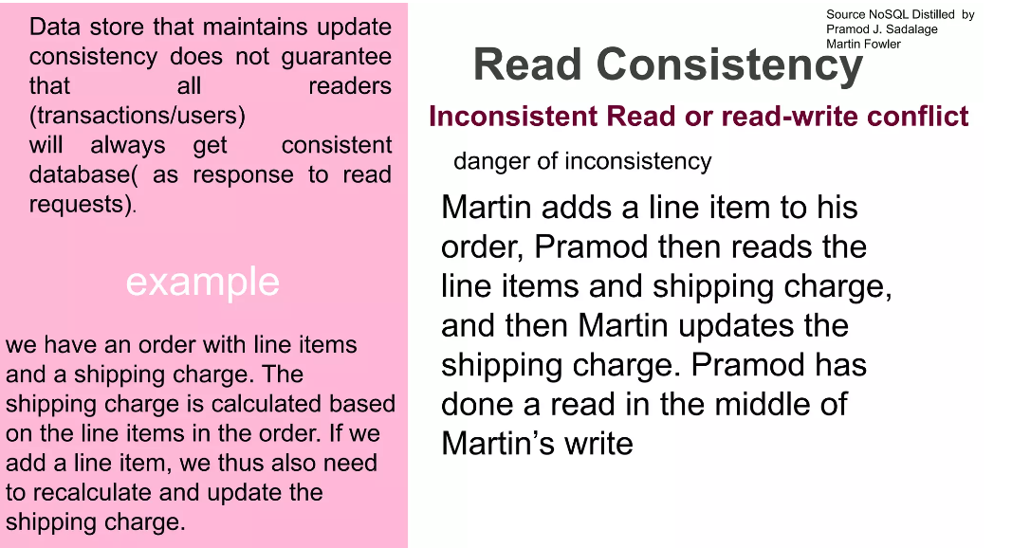

Slide 27
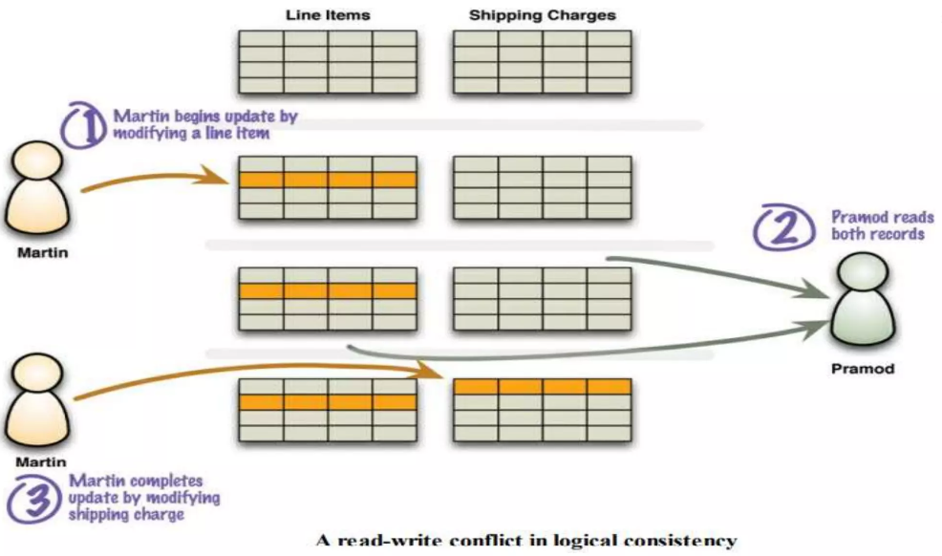

Slide 28
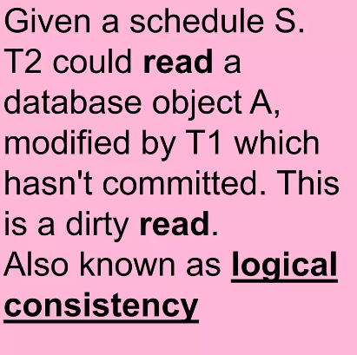
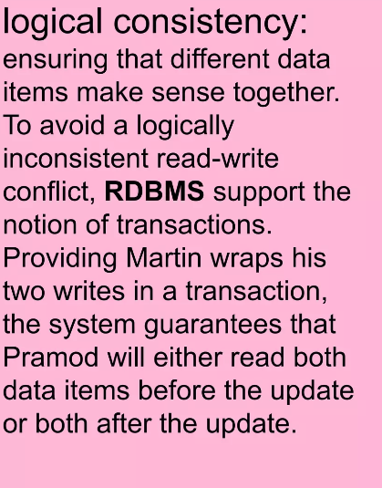

Slide 29
Read consistency
Since in NoSQL databases logical consistency is within an aggregate but not between aggregates, any update that affects multiple aggregates leaves open a time when clients could perform an inconsistent read
The length of time an inconsistency is present, is called the
inconsistency window
A NoSQL system may have a quite short inconsistency window (e.g., Amazon’s documentation says that the inconsistency window for its SimpleDB service is usually less than a second)
Once you introduce replication, however, you get a whole new kind of read inconsistency (besides logical inconsistency): Replication inconsistency

Slide 30
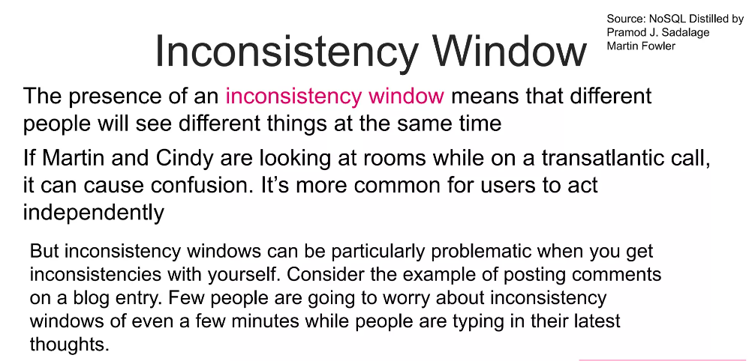

Slide 31
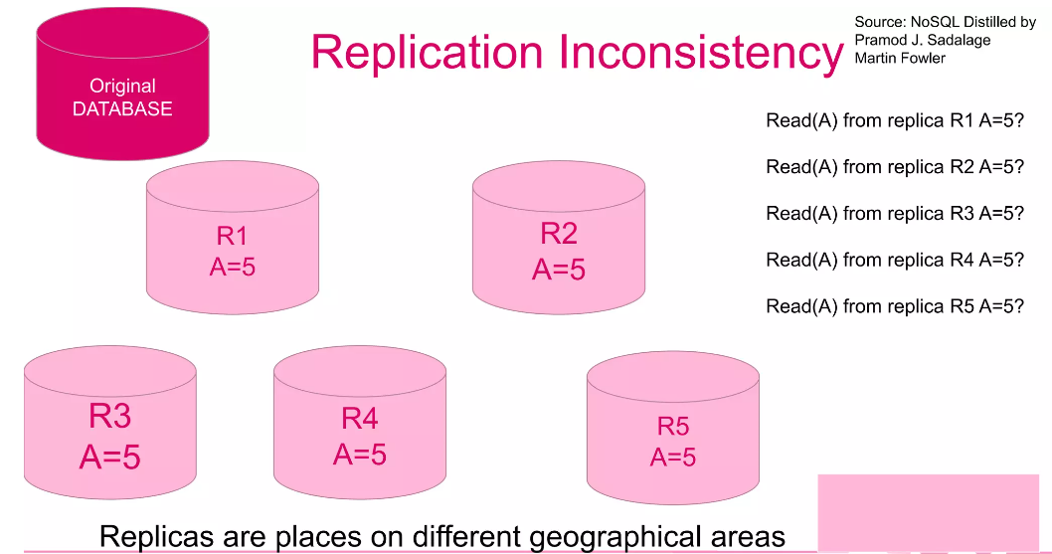

Slide 32
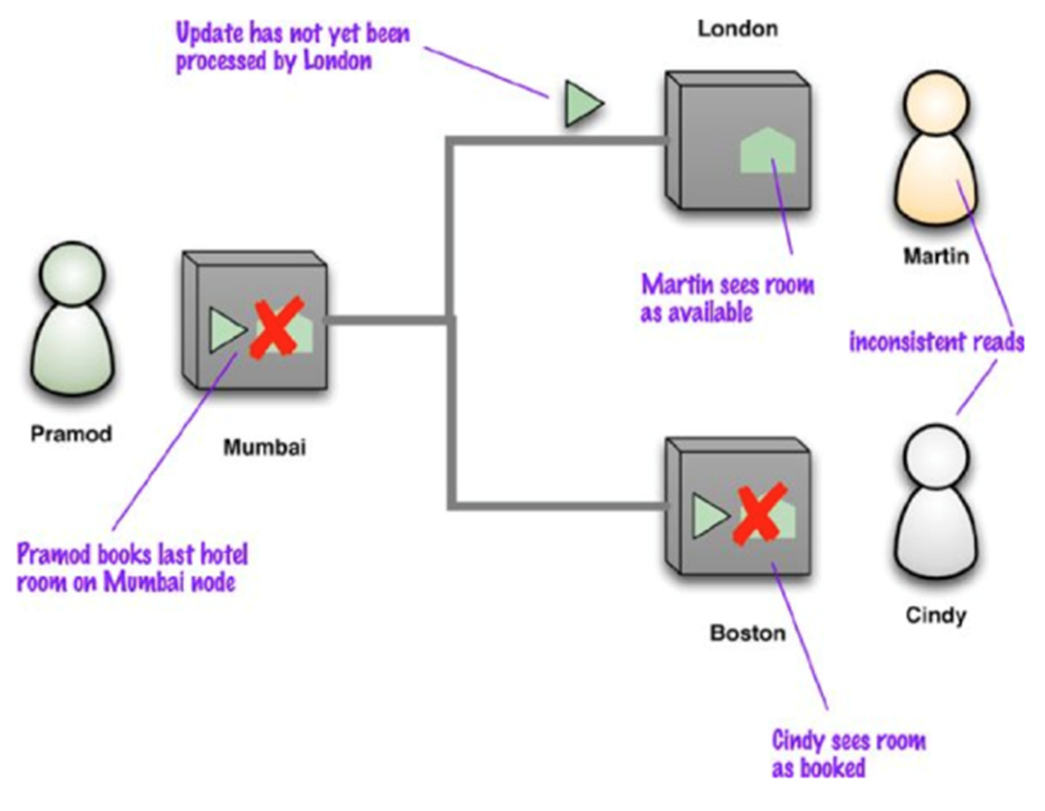
Replication consistency
Replication consistency amounts to ensuring that the same data item has the same value when read from different replicas
Example: Martin and Cindy, who are in London and Boston respectively, are on
phone to book together an hotel room. At the same time, Pramod books the last room in that hotel at the Mumbai node and the Boston node shows the booking before the London one

Slide 33
Eventually consistent
Eventually, of course, the updates propagate fully in the network, (and Martin will see the room is booked)
Therefore this situation is generally referred to as eventually consistent, meaning that at any time nodes may have replication inconsistencies but, if there are no further updates, eventually all nodes will be updated to the same value
Although replication consistency is independent from logical consistency, replication can exacerbate a logical inconsistency by lengthening its inconsistency window (for examples, under master- slave replication, inconsistency window is generally narrow on the master, but lasts for much longer on a slave)

Slide 34
Session consistency
Inconsistency windows can be particularly problematic when you get inconsistencies with yourself.
read-your-writes consistency means that, once you’ve made an update, you’re guaranteed to continue seeing that update.
There are situations where guaranteeing this may not be so obvious
Consider the example of posting comments on a blog entry. Often,
systems handle the load of such sites by running on a cluster and load-balancing incoming requests to different nodes. This means that you may post a message using one node, then refresh your browser, but the refresh goes to a different node which hasn’t received your post yet!
session consistency guarantees read-your-writes consistency within a session: if the session ends for some reason, or the user access simultaneously the same system from different computers, he/ she may lose consistency.

Slide 35
Session consistency
There are a couple of techniques to guarantee session consistency.
sticky session: a session that’s tied to one node (this is also called session affinity). The downside is that sticky sessions reduce the ability of the load balancer to do its job.
using version stamps*, ensuring that every interaction with the data store includes the latest version stamp seen by a session. The server node must then ensure that it has the updates that include that version stamp before responding to a request.
*A version stamp is a field that changes every time the data in the database changes. When you read the data you keep a note of the version stamp, so
that when you write data you can check to see if the version has changed.

Slide 36
Relaxing consistency
More in general, in distributed databases, consistency, and in particular isolation, is often relaxed for performance reasons in such a way that also conflicts typically avoided in a single-server setting (like WW conflicts) are somehow tolerated
Indeed, concurrent programming involves a fundamental tradeoff between safety (avoiding errors such as WW conflicts) and liveness (responding quickly to clients)
Also, we notice that in the presence of more than one server, such as with peer-to-peer replication, serializability is complicated by the fact that different nodes might apply the updates in a different order. Often, when people talk about concurrency in distributed systems, they talk about sequential consistency— ensuring that all nodes apply operations in the same order.

Slide 37
Properties of shared data systems
Consistency
(informally) “every request receives the right response”
E.g. If I get my shopping list on Amazon I expect it contains all the previously selected items
It is essentially what discussed so far
Availability
(informally) “each request eventually receives a response”
E.g. eventually I access my shopping list
A bit more formally: if you can talk to a node in the cluster, it can read and write data.
tolerance to network Partitions
(informally) “servers can be partitioned into multiple groups that cannot communicate with one other”
A bit more formally: the cluster can survive communication
breakages that separate the cluster into multiple partitions unable to communicate one another

Slide 38
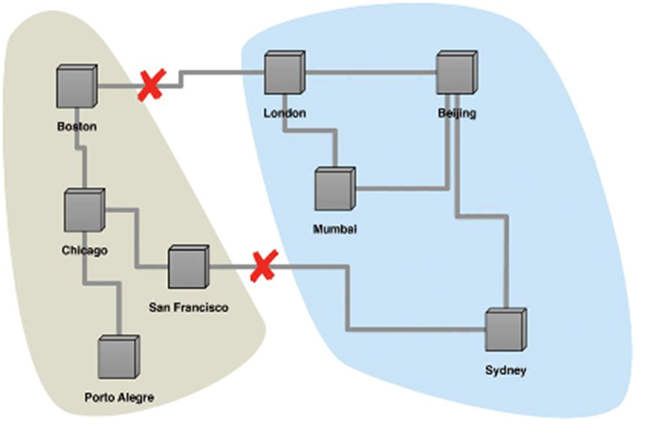
Network partitions
This situation is also known as a split brain

Slide 39
(simple) CA systems
A single-server system is the obvious example of a CA system: a system that has Consistency and Availability. Partition tolerance is not applicable here, since a single machine can’t partition. This is the world that most relational database systems live in
It is theoretically possible to have a CA cluster: However, this would mean that if a partition ever occurs in the cluster, all the nodes in the cluster would go down so that no client can talk to a node (according to definition of availability, if a node is not reachable, then it does not infer lack of capability). Realizing a CA cluster in this way is usually prohibitively expensive. Notice also that we are somehow bypassing partition tolerance here

Slide 40
The CAP Theorem
When we try to have a cluster to be really tolerant to network partitions, the CAP theorem comes into play
“Of three properties of shared-data systems (Consistency, Availability and tolerance to network Partitions) only two can be achieved at any given moment in time.”
2000: Eric Brewer, PODC conference keynote
2002: Seth Gilbert and Nancy Lynch, ACM SIGACT News 33(2)

Slide 41
The CAP Theorem - observations
CAP states that in case of failures you can have at most two of these three properties for any shared-data system
To scale out, you have to distribute resources.
P is not really an option but rather a need
The real selection is among Consistency or Availability
In almost all cases, you would choose availability over consistency.
In practice, what CAP is saying is that in a system that may suffer partitions, as distributed system do, you have to trade off consistency versus availability (if there are no strong reasons to do the converse). However, it is not a binary decision; often, you can trade off a little consistency to get some availability.

Slide 42


Example
Martin and Pramod are both trying to book the last hotel room on a system that uses peer-to-peer distribution with two nodes. If we want to ensure consistency, when Martin tries to book his room on the London node, that node must communicate with the Mumbai node before confirming the booking. But should the network link break, then neither system can book any hotel room, sacrificing availability.
London
Mumbai

Slide 43
Example
One way to improve availability is to designate one node as the master for a particular hotel and ensure all bookings are processed by that master. Should that master be Mumbai, then Mumbai can still process hotel bookings for that hotel and Pramod will get the last room, whereas Martin can see the inconsistent room information but cannot make a booking (which would in this case cause an update inconsistency). This is a lack of availability for Martin.
To gain more availability, we might allow both systems to keep accepting hotel reservations even if a link in the network breaks down. But this may cause both Martin a Pramod book the same room => Inconsistency. But in this domain it might be tolerated somehow: the travel company may tolerate some overbooking; some hotels might always keep a few rooms clear even when they are fully booked; Some hotels might even cancel the booking with an apology once they detected the conflict.

Slide 44
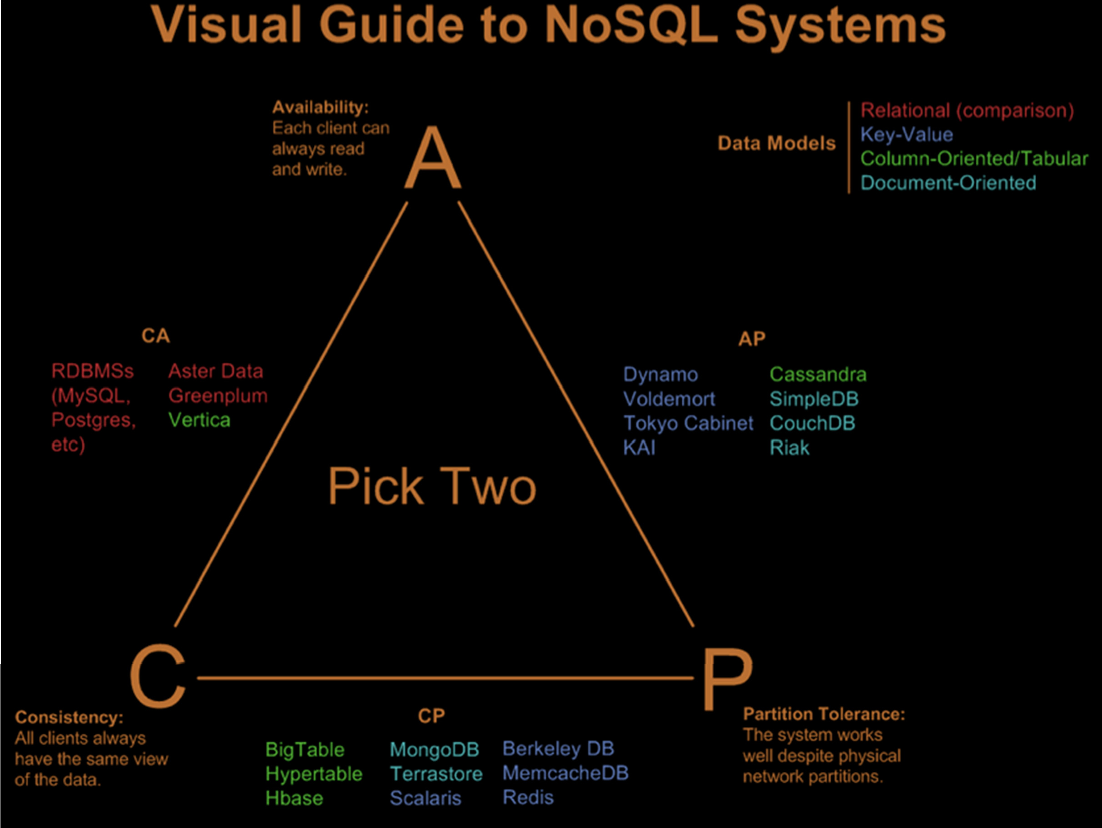

Slide 45
Relaxing consistency
The lesson here is that there are cases in which you can gracefully deal with inconsistent answers to requests
The level of inconsistency accepted completely depend on the application at hand. In general, you should establish how tolerant you are to stale reads (i.e., reading obsolete data) and how long the inconsistency window can be
Advocate of NoSQL often say that instead of following the ACID properties of relational transactions, NoSQL systems follow the BASE properties
45

Slide 46
BASE
BASE stands for Basically Available Soft State Eventually Consistent system.
Basically Available: the system is available most of the time and there could exist a subsystem temporarily unavailable
Soft State: data are “volatile” in the sense that their persistence is in the hand of the user that must take care of refreshing them
Eventually Consistent: the system eventually converges to a consistent state
46

Slide 47
CAP theorem - conclusions
It’s usually better to think not about the tradeoff between consistency and availability but rather between consistency and latency
We can always improve consistency by getting more nodes involved in the interaction, but each node we add increases the response time of that interaction
We can then think of availability as the limit of latency that we’re prepared to tolerate: once latency gets too high, we give up and treat the data as unavailable
In principle every system should be designed to ensure both C and A in normal situations. When a partition occurs, the decision among C and A can be taken. When the partition is resolved the system takes corrective action coming back to work in normal situation
47

Slide 48
CAP Theorem
Consistency: Consistency is about having a single, up-to-date, readable version of our data available to all clients.
Our data should be consistent - no matter how many clients reading the same items from replicated and distributed partitions we should get consistent results. All writes are atomic and all subsequent requests retrieve the new value.
High availability: This property states that the distributed database will always allow database clients to make operations like select or update on items without delay.
Internal communication failures between replicated data shouldn’t prevent operations on it. The database will always return a value as long as a single server is running.
Partition tolerance: This is the ability of the system to keep responding to client requests even if there’s a communication failure between database partitions.
The system will still function even if network communication between partitions is temporarily lost.

Slide 49
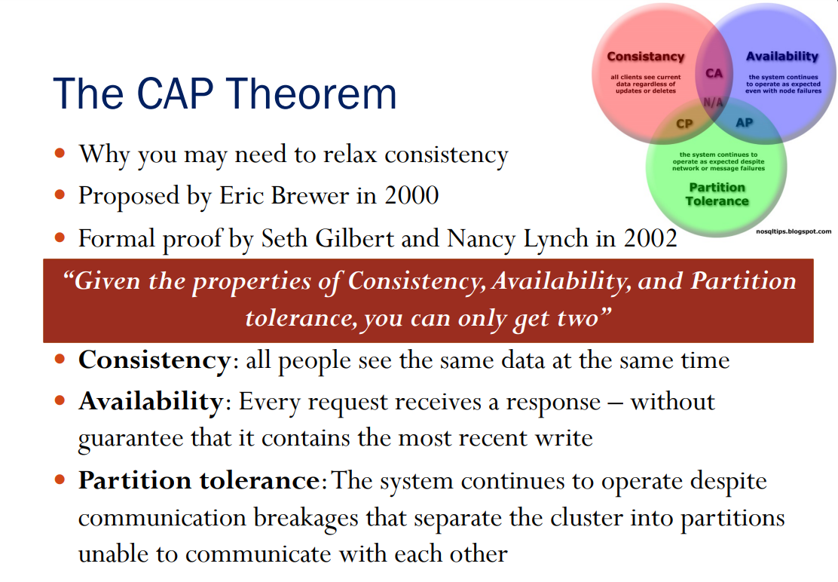

Slide 50
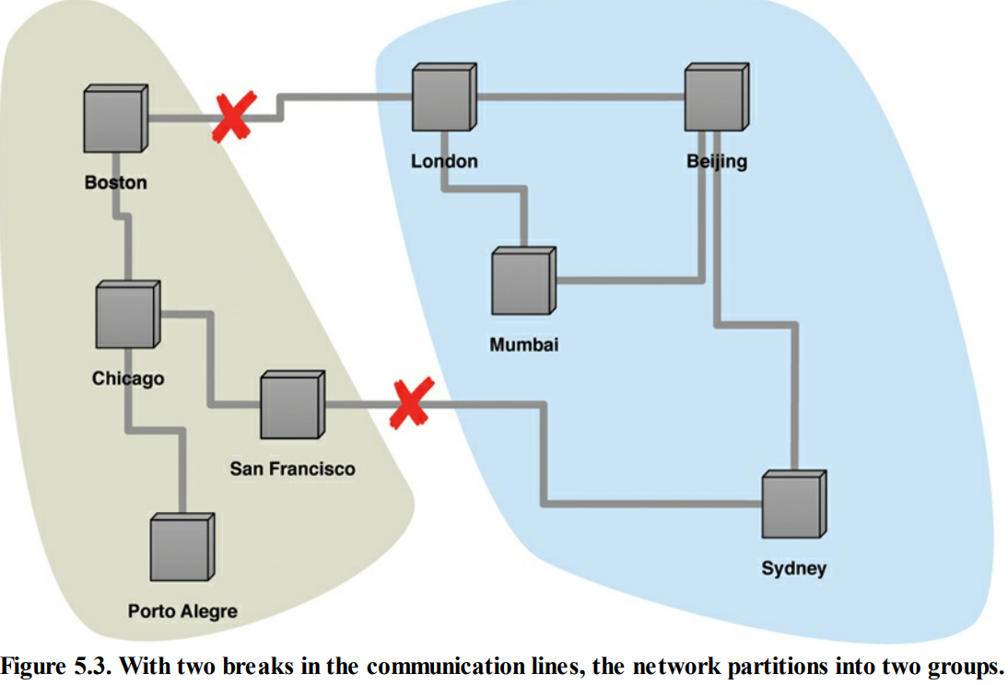

Slide 51
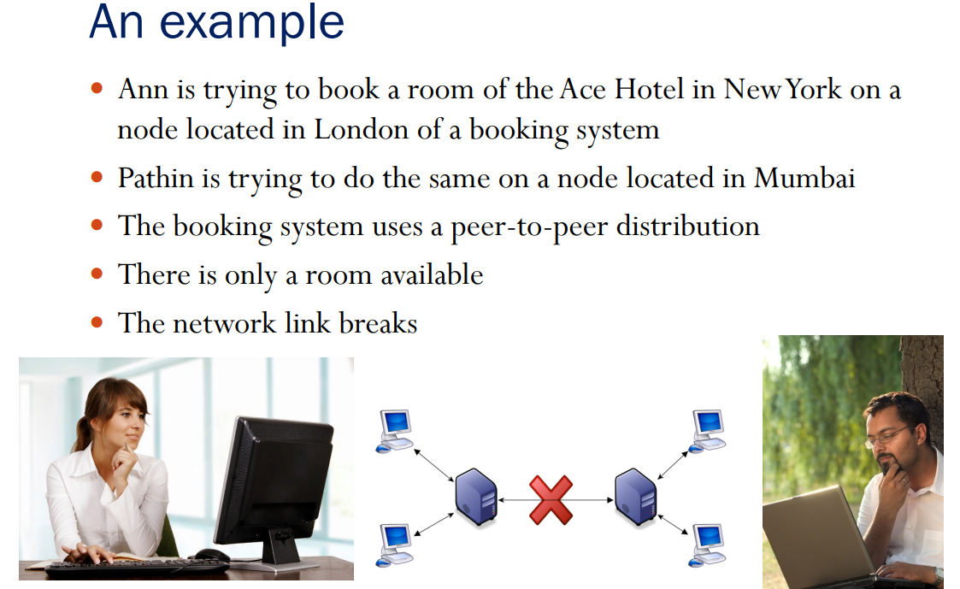

Slide 52
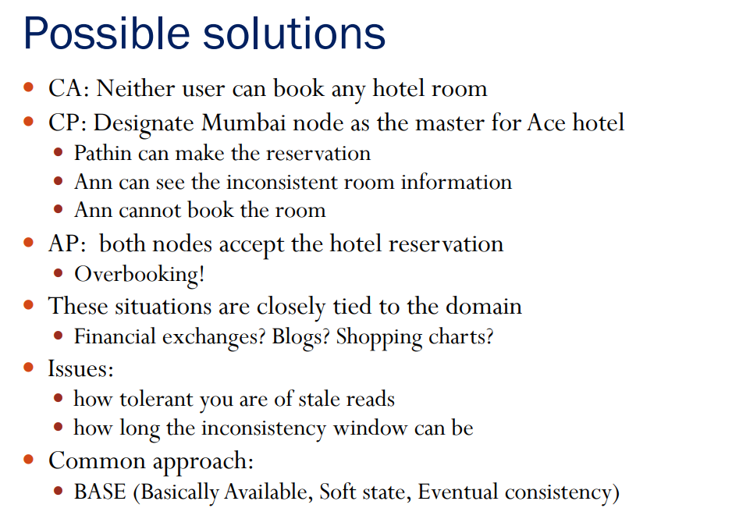

Slide 53
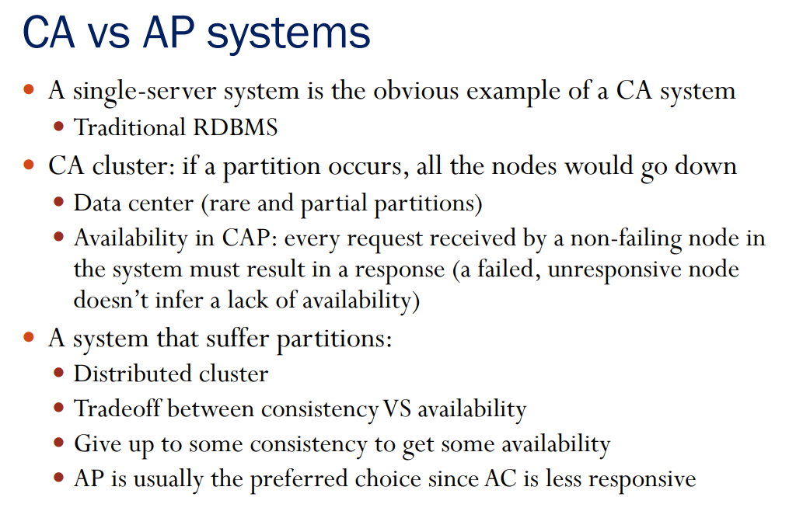

Slide 54
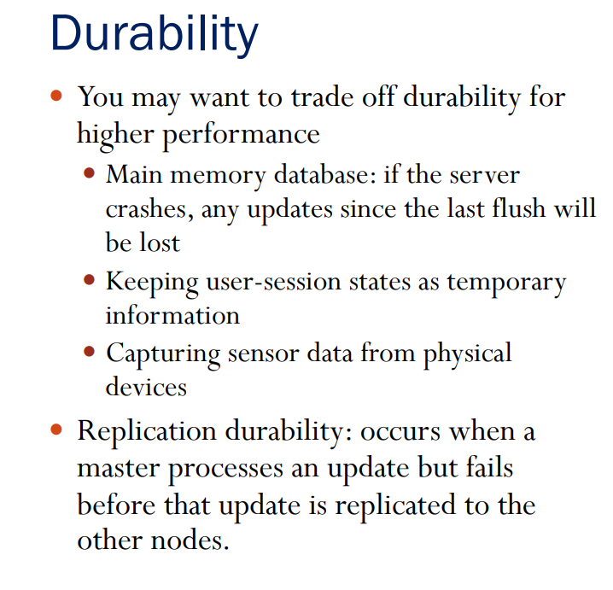

Slide 55
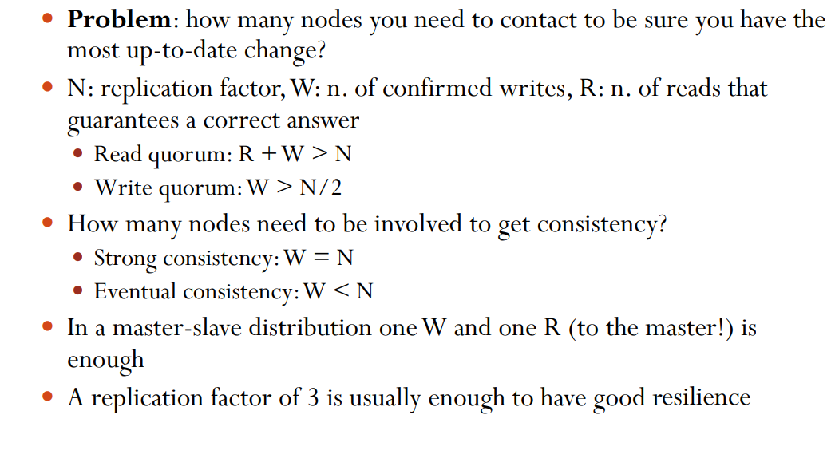
Practical approach: Quorums

Slide 56
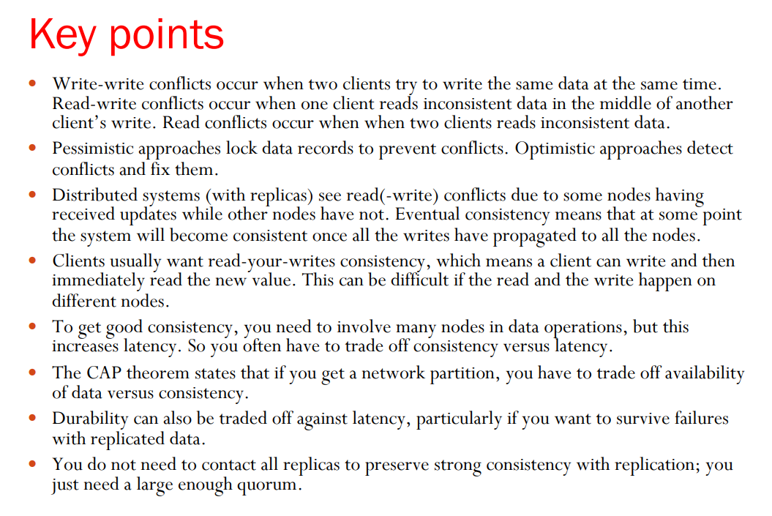

Slide 57
Version Stamps
Chapter 6

Slide 58
Version Stamp helps to detect concurrency conflicts - when you read data, then update it, you can check the version stamp to ensure nobody updated the data between read and write.
Version stamps can be implemented using Counters, GUIDs, Content hashes, timestamps or a combination of these.
With distributed systems, a Vector of version stamps allows you to detect when different nodes have conflicting updates.

Slide 59
A business transaction is an event involving an interchange of goods, money or services between two or more parties.
The transaction can be as brief as a cash purchase or as long lasting as a service contract extending over years.
The business transaction can be between two parties engaged in the business and conducting the transaction for their mutual benefits or between a business entity like retail shop and a customer.

Slide 60
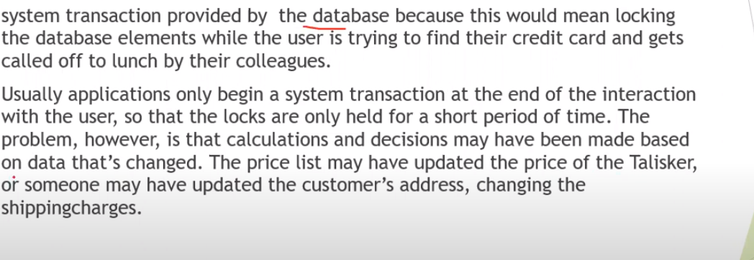

Slide 61

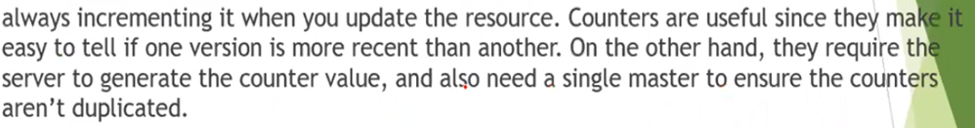

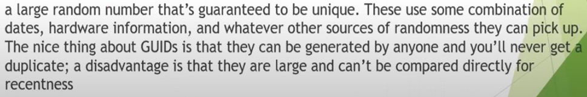
Various ways to construct version stamps

Slide 62
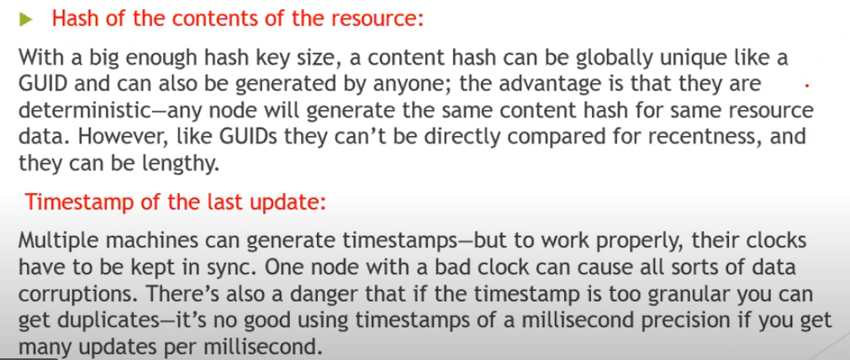

Slide 63
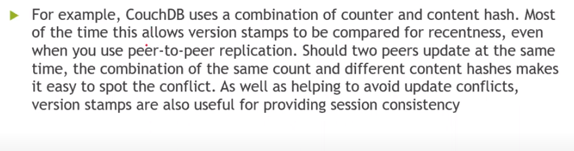

Slide 64
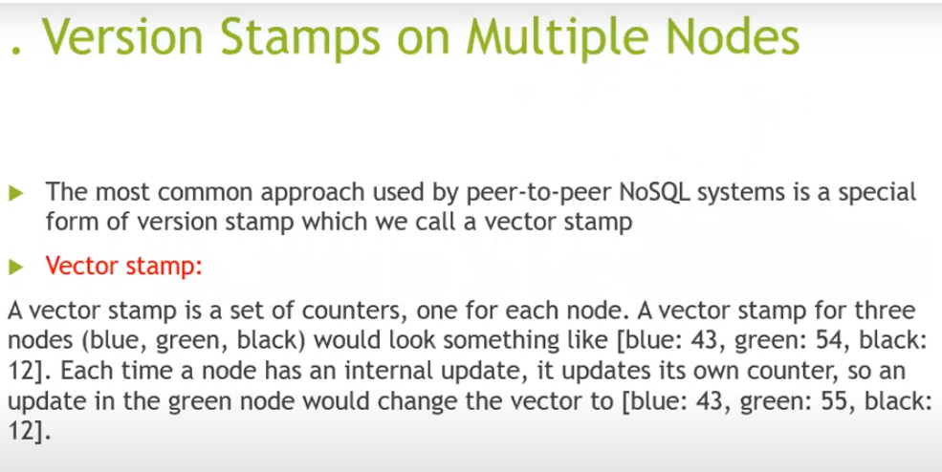

Slide 65
